Slide 1
Changing the subject to suit the context
Expressions and formulae

Slide 2
How our teaching resources are designed for the classroom

Slide 3
I can evaluate different problems to ascertain when rearranging a formula is beneficial.

Slide 4


The subject of an equation/a formula is a variable that is expressed in terms of other variables. It should have an exponent of 1 and a coefficient of 1.
For example, a is the subject of this formula
but, a² is not the subject of this formula

Slide 5

Changing the subject to suit the context
Rearranging additive and multiplicative steps
Rearranging equations to find the gradient

Slide 6
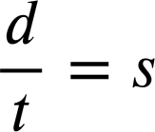
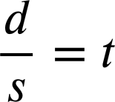
Rearranging additive and multiplicative steps
Multiplicative relationships can be rearranged into a family of facts.
If 4 × 5 = 20 then…
20 ÷ 5 = 4
5 × 4 = 20
20 ÷ 4 = 5
We can rearrange multiplicative formula in the same way.
speed × time = distance
s × t = d
d ÷ t = s
t × s = d
d ÷ s = t

Slide 7
Rearranging additive and multiplicative steps
The variable we wish to calculate determines which rearrangement we use.
s × t = d
t × s = d
A car travels at 50 mph for three hours. How far has it travelled?
We want to know distance so we want a rearrangement whereby distance is the subject.

Slide 8
Rearranging additive and multiplicative steps
The variable we wish to calculate determines which rearrangement we use.
s × t = d
t × s = d
A car travels at 50 mph for three hours. How far has it travelled?
s × t = d
50 × 3 = d
d = 150 miles

Slide 9
Rearranging additive and multiplicative steps
The variable we wish to calculate determines which rearrangement we use.
s × t = d
t × s = d
A plane has to fly 6000 miles and will travel at 400 mph. How long will the journey take?
We want to know time so we want a rearrangement whereby time is the subject.

Slide 10
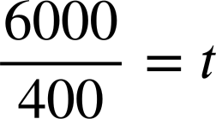
Rearranging additive and multiplicative steps
The variable we wish to calculate determines which rearrangement we use.
s × t = d
t × s = d
A plane has to fly 6000 miles and will travel at 400 mph. How long will the journey take?
t = 15 hours

Slide 11
Rearranging additive and multiplicative steps
In Physics you may encounter a formula for calculating the acceleration of a particle.
acceleration = final velocity − initial velocity
time

Slide 12
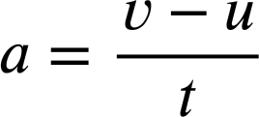
Rearranging additive and multiplicative steps
In Physics you may encounter a formula for calculating the acceleration of a particle.
acceleration (a) = final velocity (v) − initial velocity (u)
time (t)
This format, with acceleration (a) as the subject, is good for calculating acceleration if you know the final velocity (v), the initial velocity (u), and the time (t).

Slide 13
Rearranging additive and multiplicative steps
In Physics you may encounter a formula for calculating the acceleration of a particle.
acceleration (a) = final velocity (v) − initial velocity (u)
time (t)
But what if we knew a, u, and t and wanted to know v, the final velocity?

Slide 14


Rearranging additive and multiplicative steps
We can make v the subject so that it is expressed in terms of the other variables.
v is now the subject. We can substitute in the other variables now to quickly find it’s value.

Slide 15





Rearranging additive and multiplicative steps
Which of these rearrangements would be most useful if we knew a, v, and t and wanted to know u, the initial velocity?
If we want to know u, we want u to be the subject.
Not a valid rearrangement.

Slide 16
Rearranging additive and multiplicative steps
It’s not just in maths and physics that we see formulae.
Break-Even is a crucial formula in business, especially for new entrepreneurs.
fixed costs
Break-Even Quantity =
selling price − variable cost per unit
The Break-Even Point is the quantity of units a business has to sell in order to start making a profit.

Slide 17
Rearranging additive and multiplicative steps
Example, you start a coffee shop with £16 000 of set-up costs. Once up and running you sell each coffee for £3 and they cost £1 each to produce. When do you break-even?
fixed costs
Break-Even Quantity =
selling price − variable cost per unit
£16 000
£16 000
Break-Even Quantity =
=
= 8 000 units
£3 − £1
£2
Can you sell 8 000 coffees? How long will it take?

Slide 18
Rearranging additive and multiplicative steps
But, what if you knew the quantity of units you could sell?
fixed costs
Break-Even Quantity =
selling price − variable cost per unit
selling price − variable cost per unit
If you knew that quantity, and your fixed costs, and your variable cost per unit, you can then calculate the selling price you would have to charge in order to make a profit.
If you knew that quantity, and your fixed costs, and your variable cost per unit, you can then calculate the selling price you would have to charge in order to make a profit.

Slide 19
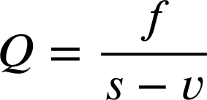
Rearranging additive and multiplicative steps
In order to do that we need to make ‘selling price’ the subject of the formula.
fixed costs
Break-Even Quantity =
selling price − variable cost per unit

Slide 20

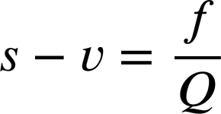
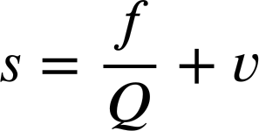
Rearranging additive and multiplicative steps
In order to do that we need to make ‘selling price’ the subject of the formula.
Selling price (s) is now the subject.

Slide 21
Rearranging additive and multiplicative steps
We can now calculate what price we need to sell each unit for in order to start making a profit.
fixed costs
selling price =
− variable cost per unit
Break-Even Quantity
Selling price (s) is now the subject.

Slide 22
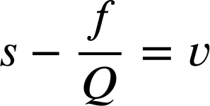
Rearranging additive and multiplicative steps
Cost control is a really important element of business.
Rearrange our break-even formula to make ‘Variable cost per unit (v)’ the subject.

Slide 23
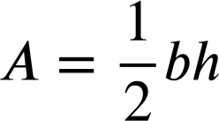
Rearranging additive and multiplicative steps
1) a) Rearrange the formula for circumference of a circle so that it would be more efficient for finding the radius if you knew the circumference.
C
r
C = 2πr
b) Rearrange the formula for area of a triangle so that it would be more efficient for finding the height if you knew the area and the base.
Height
Base

Slide 24
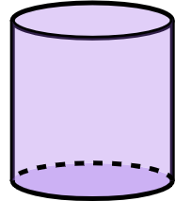
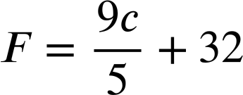
Rearranging additive and multiplicative steps
1) c) Rearrange the formula for surface area of a cylinder so that it would be more efficient for finding the height if you knew the surface area and radius.
r
h
A = 2πr² + 2πrh
2) This is the formula for converting Celsius into Fahrenheit.
Show two ways to rearrange the formula so that it converts Fahrenheit into Celsius.

Slide 25
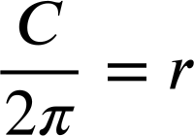
Rearranging additive and multiplicative steps
1) a) Rearrange the formula for circumference of a circle so that it would be more efficient for finding the radius if you knew the circumference.
1) a) Rearrange the formula for circumference of a circle so that it would be more efficient for finding the radius if you knew the circumference.
C
r
C = 2πr
r, the unknown we want to find, is now the subject.

Slide 26

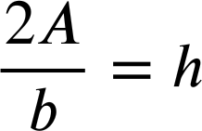
Rearranging additive and multiplicative steps
1) b) Rearrange the formula for area of a triangle so that it would be more efficient for finding the height if you knew the area and the base.
1) b) Rearrange the formula for area of a triangle so that it would be more efficient for finding the height if you knew the area and the base.
Height
Base
h, the unknown we want to find, is now the subject.

Slide 27
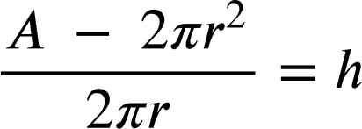
Rearranging additive and multiplicative steps
1) c) Rearrange the formula for surface area of a cylinder so that it would be more efficient for finding the height if you knew the surface area and radius.
r
1) c) Rearrange the formula for surface area of a cylinder so that it would be more efficient for finding the height if you knew the surface area and radius.
h
A = 2πr² + 2πrh
A − 2πr² = 2πrh
h, the unknown we want to find, is now the subject.

Slide 28
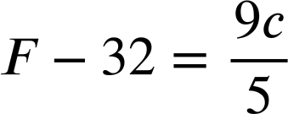



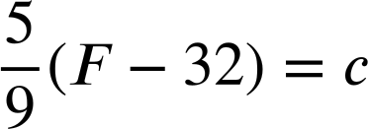
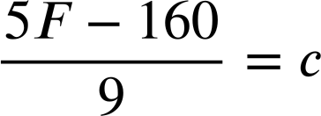
Rearranging additive and multiplicative steps
2) This is the formula for converting Celsius into Fahrenheit.
Show two ways to rearrange the formula so that it converts Fahrenheit into Celsius.
Step one:
×5 all terms
Step one:
−32 both sides

Slide 29
Changing the subject to suit the context
Rearranging additive and multiplicative steps
Rearranging equations to find the gradient

Slide 30
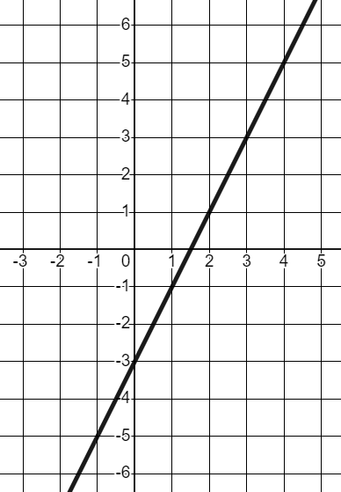
Rearranging equations to find the gradient
If we have a linear equation in the form y = mx + c there are key features we can quickly spot.
y
The linear equation y = 2x − 3
A gradient of 2
A y-intercept of (0,−3)
x

Slide 31
Rearranging equations to find the gradient
If we have a linear equation in the form y = mx + c there are key features we can quickly spot.
y
In the form y = mx + c
Gradient (m)
y-intercept (c)
x
y is the subject.

Slide 32
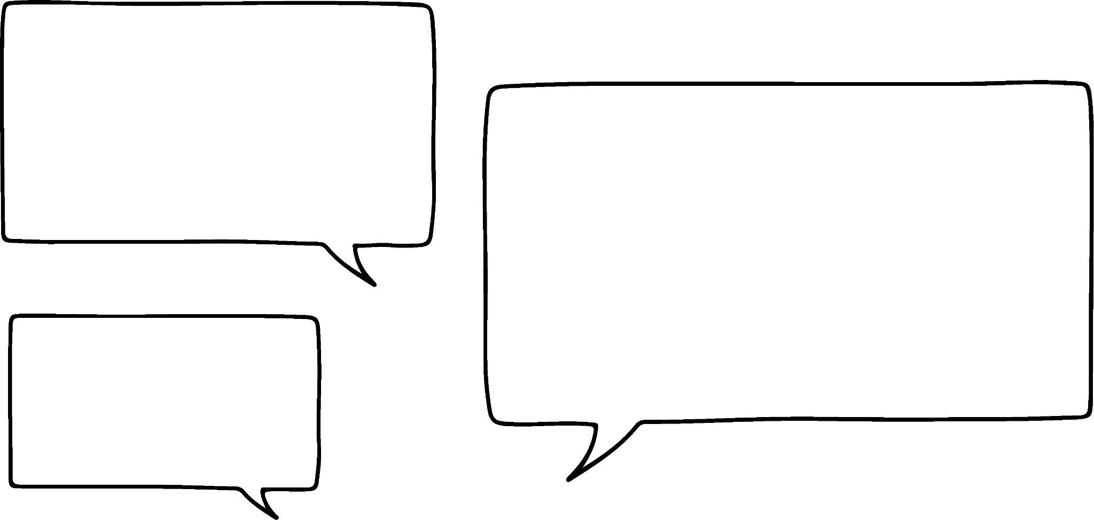



Rearranging equations to find the gradient
Sometimes we see linear equations in the form ax + by = c
In this form the gradient is not so easy to spot.
Aisha, Izzy and Alex are discussing the equation 4x + 5y = 40
I think the gradient will be 4 because that’s the coefficient of x
I think it will be either 40 ÷ 5, or 40 ÷ 4
I think the gradient might be 5, the coefficient of y this time.
What do you think?

Slide 33
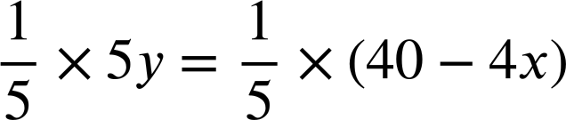
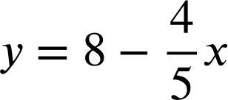

Rearranging equations to find the gradient
The equation 4x + 5y = 40
4x + 5y = 40
5y = 40 − 4x
If we make y the subject, we’ll know what the gradient is.
With y now the subject, we can see the gradient is

Slide 34
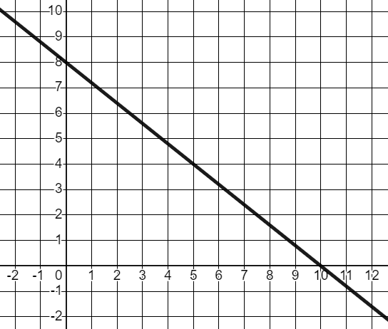
Rearranging equations to find the gradient
The equation 4x + 5y = 40
4x + 5y = 40
y
5y = 40 − 4x
5
−4
The gradient
x
The y-intercept (0, 8)

Slide 35
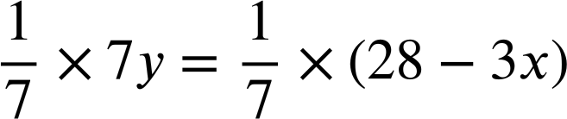
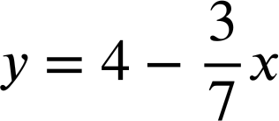

Rearranging equations to find the gradient
Work out the gradient and the y-intercept of the equation below by rearranging to make y the subject.
3x + 7y = 28
7y = 28 − 3x
Gradient , y-intercept (0, 4)

Slide 36
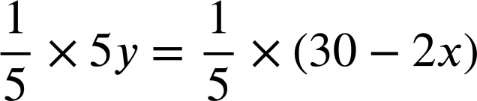
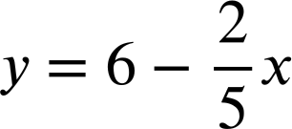

Rearranging equations to find the gradient
Work out the gradient and the y-intercept of the equation below by rearranging to make y the subject.
Work out the gradient and the y-intercept of the equation below by rearranging to make y the subject.
3x + 7y = 28
2x + 5y = 30
7y = 28 − 3x
5y = 30 − 2x
Gradient , y-intercept (0, 4)
Gradient , y-intercept (0, 6)

Slide 37
Rearranging equations to find the gradient
1) Work out the gradient and the y-intercept of the lines given by these equations by rearranging to make y the subject.
a) x + 4y = 12
b) 2x + 6y = −18
c) 8x − 2y = 15

Slide 38
Rearranging equations to find the gradient
2) Rearrange this general form of a linear equation to make y the subject and find an expression for the gradient and y-intercept when in this form.
ax + by = c

Slide 39
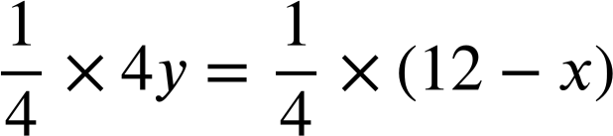
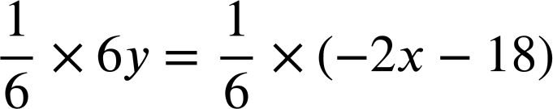
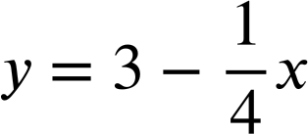
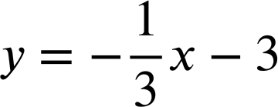


Rearranging equations to find the gradient
1) Work out the gradient and the y-intercept of the lines given by these equations by rearranging to make y the subject.
a) x + 4y = 12
b) 2x + 6y = −18
4y = 12 − x
6y = −2x − 18
Gradient , y-intercept (0, 3)
Gradient , y-intercept (0,−3)

Slide 40
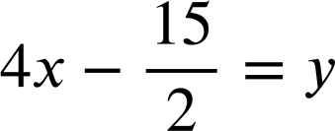
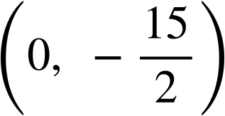
Rearranging equations to find the gradient
1) Work out the gradient and the y-intercept of the lines given by these equations by rearranging to make y the subject.
c) 8x − 2y = 15
8x = 15 + 2y
8x − 15 = 2y
Gradient 4, y-intercept

Slide 41

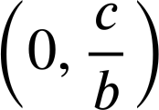
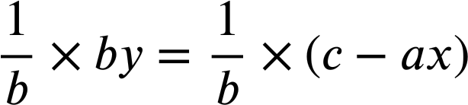
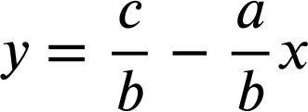
Rearranging equations to find the gradient
2) Rearrange this general form of a linear equation to make y the subject and find an expression for the gradient and y-intercept when in this form.
ax + by = c
For the form ax + by = c the gradient is
and the y-intercept is
by = c − ax

Slide 42
Changing the subject to suit the context
Rearranging can be beneficial depending upon which unknown in a formula you are trying to find.
This will change depending on the context.
Changing the subject requires similar skills to solving an equation.

Slide 43

© Oak National Academy 2024.
Produced in partnership with Mathematics in Education and Industry.
Licensed on the Open Government Licence v3.0, except where otherwise stated. See Oak terms and conditions.

